Slide 1
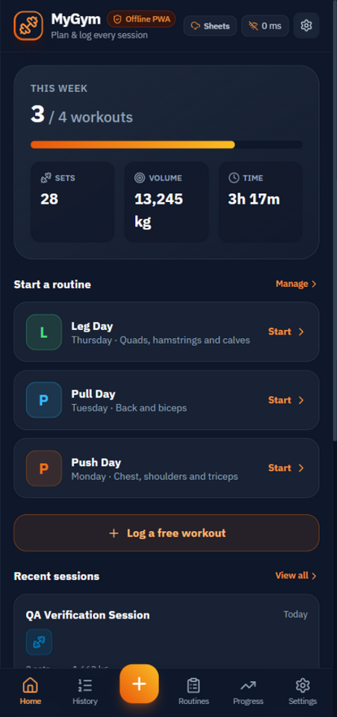
OFFLINE-FIRST WORKOUT TRACKER
MyGym
Plan routines. Log every set. See the progress.
100% offline • data stays on your device • optional Google Sheets backup
USER GUIDE · FEATURE WALKTHROUGH

Slide 2
SETUP
Get it on your home screen
Open the app
my-gym-hammad42.netlify.app in Chrome or Safari.
Add to Home screen
Android: menu → Add to Home screen. iPhone: Share → Add to Home Screen.
Launch from the icon
Opens full-screen and works with no signal at all.
First launch
Demo workouts, 21 exercises and 3 routines are seeded so charts have data.
Go live when ready
Settings › Clear all logged workouts keeps routines, drops samples.

Slide 3
HOME
Your training dashboard
This Week
Sessions vs your weekly goal, with a progress bar.
Streak
Consecutive weeks hitting the goal - the flame badge.
Sets / Volume / Time
This week's totals. Warm-ups count as sets, not volume.
Start a routine
One tap pre-fills a workout with the plan.
Recent sessions
Your last five workouts at a glance.

Slide 4
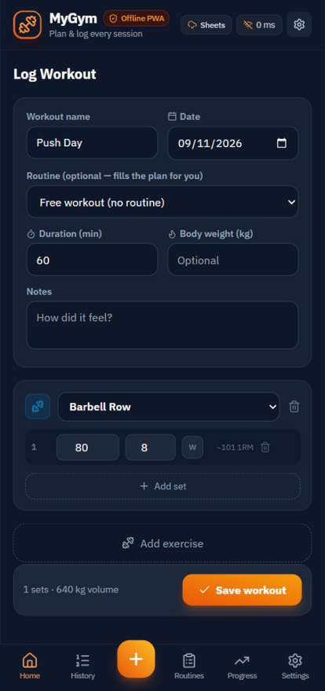
LOG
Logging a workout
Session details
Name, date (today by default), duration, body weight, notes.
Add exercises & sets
New sets carry the previous weight and reps forward.
W = warm-up
Warm-up sets are excluded from volume and records.
Live ~1RM
Estimated one-rep max updates as you type (Epley).
Sticky footer
Running set count and total volume before you save.
Save
One atomic write - session and sets land together.

Slide 5
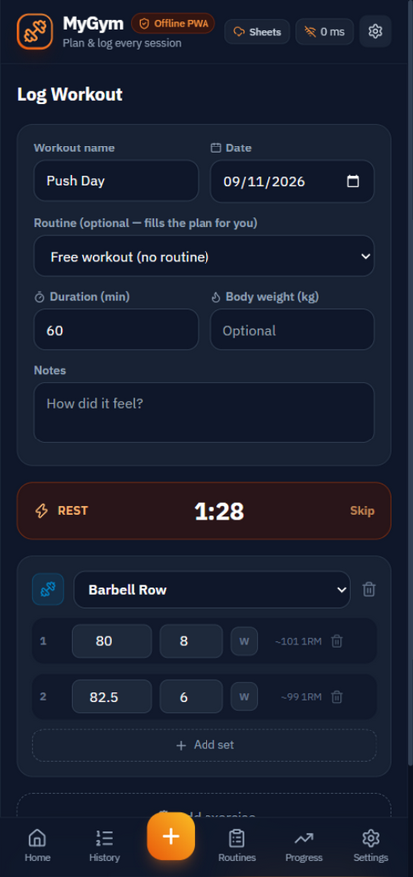
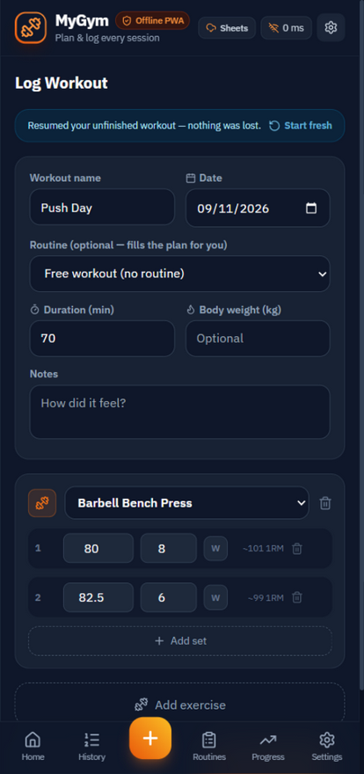
BUILT FOR THE GYM FLOOR
Rest timer & draft recovery
Deadline-based countdown
Screen lock and background tabs cannot drift it.
Beep + vibration
You know it finished from across the gym.
Survives navigation
The rest keeps running while you check history.
Auto-saved draft
Every keystroke is stored in the local database.
Resume banner
Return to find everything exactly where you left it.
Leave guard
The app asks before you walk away mid-workout.

Slide 6
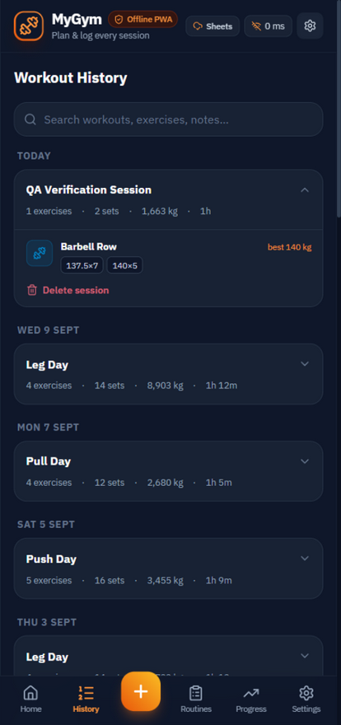
HISTORY
Every session, searchable
Grouped by day
Today, Yesterday, then dates - newest first.
Tap to expand
Every set as a chip: weight × reps; blue = warm-up.
Best set
The heaviest set of the session, highlighted.
Search
Filter by workout name, exercise or notes.
Delete safely
Two-step confirm; sets are removed with the session.

Slide 7
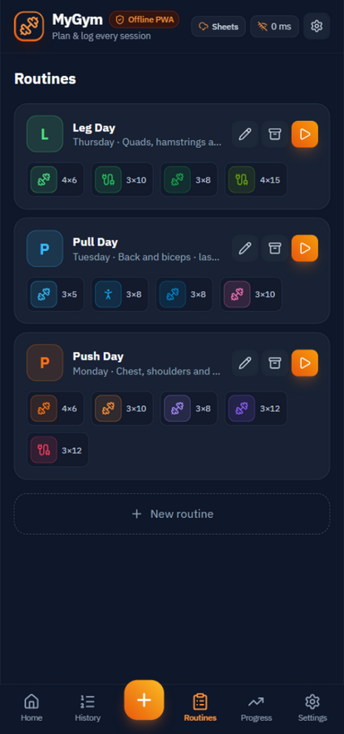
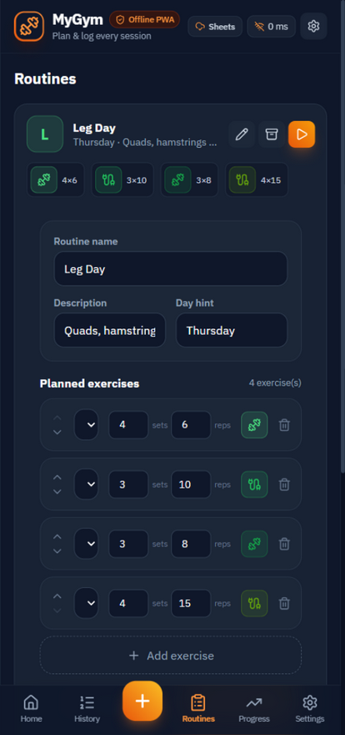
PLAN
Routines: your training templates
Plan chips
Each routine shows target sets × reps per exercise.
One-tap start
The orange play button pre-fills a workout.
Full editor
Rename, day hint, add / reorder / remove exercises.
Targets
Set the sets and reps you're aiming for per exercise.
Archive, don't delete
Old routines hide without breaking history.

Slide 8
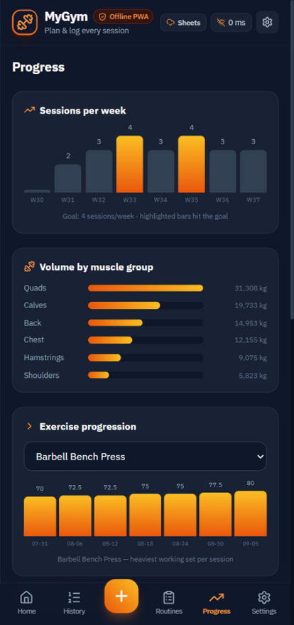
PROGRESS
Charts & personal records
Sessions per week
Last 8 weeks; goal-hitting weeks glow orange.
Volume by muscle group
Tonnage per body part, working sets only.
Exercise progression
Heaviest working set per session, per exercise.
Personal records
Best set and best estimated 1RM, with dates.
Honest numbers
Warm-ups and bodyweight reps never fake a record.

Slide 9
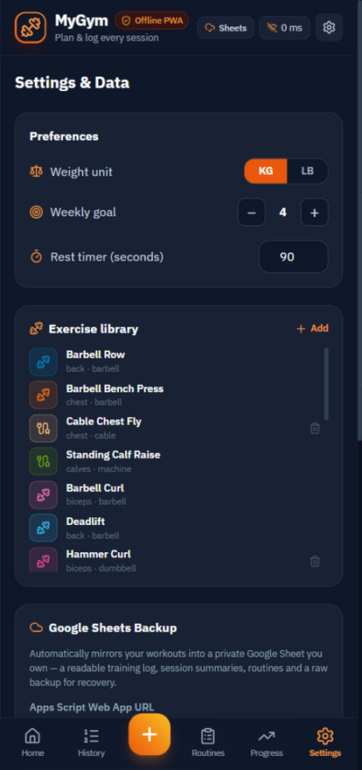
SETTINGS
Make it yours, keep it accurate
kg / lb conversion
Switching units rewrites stored weights - history stays correct.
Weekly goal
1-14 sessions; drives the Home bar and streak.
Rest timer length
15-600 seconds, applied to every new set.
Exercise library
Add custom exercises; used ones archive, never break.
Export / import
Full JSON backup; import shows what it will replace.

Slide 10
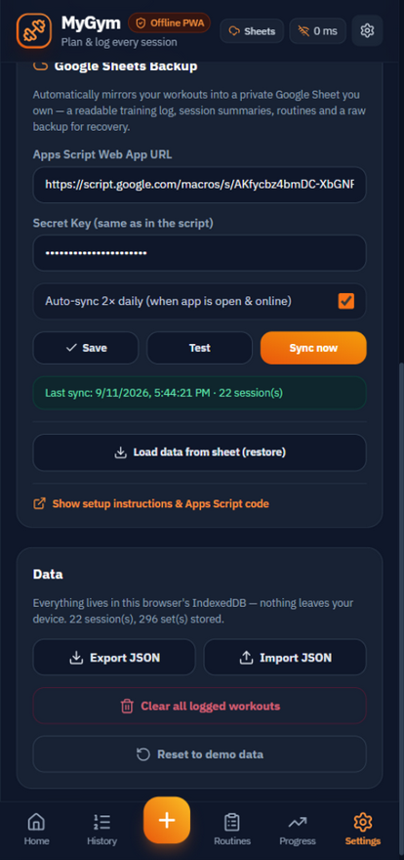
BACKUP
Google Sheets mirror
Your own spreadsheet
A readable log, session summaries, routines, raw backup.
One-time setup
Copy the Apps Script, set your password, paste the URL.
Auto-sync 2× daily
Background sync while online; never mid-workout.
Restore from sheet
Pull everything back down to any device.
Secret stays secret
The key authenticates requests; it is never stored in the sheet.
Chunked uploads
Years of training sync fine - payloads are split automatically.

Slide 11
GOOD TO KNOW
Offline by default
Works with zero signal
After the first load, every screen is available offline. Sync simply waits.
Storage is protected
The app requests persistent storage so your browser cannot evict your data.
Updates are automatic
New versions install on the next online launch; data is untouched.
Weekly volume is working sets
Warm-ups count as sets but not as volume or records - by design.
Moving phones
Export JSON on the old device, import on the new - or restore from the sheet.
Demo data
First launch includes samples; clear them in Settings when you go live.

Slide 12
Ready for your next session?
my-gym-hammad42.netlify.app
Add it to your home screen and start logging.
MYGYM · PLAN · LOG · PROGRESS

